Slide 1

Chapter 6
Employee Benefits

Slide 2
Assignment
Access the Types of Retirement Accounts assignment in Google Classroom.
Research the four types of Retirement accounts listed
List 3 – 4 key points about each in the correct column in the assignment along with the URL from the article you used.

Slide 3
Retirement benefits

Slide 4
Average Social Security Check by Age
AGE | AVERAGE BENEFIT | AGE | AVERAGE BENEFIT
62 | $1,130 | 81 | $1,515
63 | $1,161 | 82 | $1,494
64 | $1,229 | 83 | $1,459
65 | $1,321 | 84 | $1,426
66 | $1,489 | 85 | $1,415
67 | $1,504 | 86 | $1,415
68 | $1,522 | 87 | $1,431
69 | $1,522 | 88 | $1,435
70 | $1,612 | 89 | $1,430

Slide 5
Retirement Benefits
401 K
403 B for Non-Profits
Traditional IRA
Roth IRA

Slide 6
Benefits and Incentives
Savings Plans / Retirement Plan (401K)
Employee contributes percentage of check (5 – 10%)
Employer will match employee contributions: Ex: up to 5%
Money is invested in stocks, bonds, or annuities
Taken out before taxes
Can invest $23,000 under age 50, or $30,500 over age 50
Upon retirement employee receives monthly check – earliest 59.5 (not for the rest of your life, until gone)

Slide 7
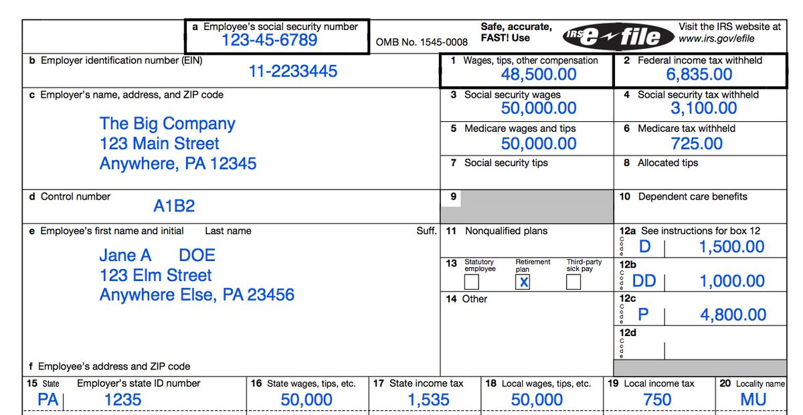

Slide 8
403 B
A retirement plan for certain employees of public schools, tax-exempt organizations or churches can set up 403(b)
Employees contribute some of their salary to the plan and have significant tax advantages for
pre-tax contributions and earnings on these amounts are not taxed until they are distributed from the plan.
Sometimes the employer may also contribute to the plan for employees.
$23,000 in 2024 under 50, $30,500 if over 50
Can’t withdraw until after age 59½;

Slide 9
Example
Free Money!
You make $100,000 a year
Your employer offers a 401k matching of 50% up to the first 6% you elect to contribute.
If you contribute 6% of your annual earnings ($6,000), your employer would contribute an additional 50% of that amount.
So, 3,000 free dollars.

Slide 10
IRA = Investment Retirement Account
IRA - Specialized savings accounts specifically geared for post-retirement funding
Two Types:
Traditional IRA
Roth IRA

Slide 11
IRA Roth Vs Traditional
Traditional IRA – Choose One
$7000 per year max
Contributions are pre-tax – taken out and tax-deductible
$50,000 gross salary If you deposit $7,000 into a Traditional IRA
$50,000 -$7,000=$43,000 (new taxable income)
As it grows/earns money, all earning are taxable upon withdrawal
When you withdraw at retirement (59.5), it is taxed at that time
Must Withdraw at age 72 ( changed 2020 to 72)
Roth IRA
$7000 per year max ($8000 if over age 50)
Contributions made after-tax
Buy set amount after your taxes are withheld. So this money is already taxed
Invested in the stock market and all earning are tax free when you withdraw
Can withdraw it at 59.5 or later for no penalty
Withdrawals/distributions are tax-free

Slide 12
You can buy Both a Traditional IRA and a Roth IRA at the same time. However, combined you can not exceed $7,000 before 50 and $8000 after 50

Slide 13
Example
23,500 401K ($30,000 over 50)
7000 IRA (Traditional or Roth)
$30,000 to a 403B
Filing Status | 2022 MAGI | 2023 MAGI | Contribution Limit
Married Filing Jointly | Less than $204,000 | Less than $218,000 | 2023: $6,500 ($7,500 if you’re age 50 or older)
 | $204,000 to $213,999 | $218,000 to $227,999 | Reduced
 | $214,000 and above | $228,000 and above | Not eligible
Single | Less than $129,000 | Less than $138,000 | 2023: $6,500 ($7,500 if you’re age 50 or older)
 | $129,000 to $143,999 | $138,000 to $152,999 | Reduced
 | $144,000 or more | $153,000 or more | Not eligible
Married filing separately | Less than $10,000 | Less than $10,000 | Reduced
 | $10,000 or more | $10,000 or more | Not eligible

Slide 14
Other Benefits

Slide 15
Benefits and Incentives
Profit Sharing
- All Employees receive a portion of company profits at end of year
More money for company means more money for employee
Considered Incentive pay: encourages employees to work harder
Leave of absence
Employee may leave job (without pay) for an approved reason (children, school, etc) and return to the same job with the same pay later
Sometimes 1 – 2 years allowed
Not under FMLA
Bonuses
money given to employees as a reward if they meet company goals
Usually paid to management and or supervisory level employees but can be all employees
Bonuses paid for quality of work, years of service, money made, etc.
Bonuses are taxable – usually at 48%

Slide 16
Benefits and Incentives
Stock Options
Stock purchase options give employees the right to buy a set number of shares of the company’s stock at a fixed rate by a certain time
Given to employees (executives) as performance/profit incentives
Example: Allowed to purchase 15000 shares at $20 per share
Employee Assistance
program that offers free and confidential short-term counseling, referrals, and follow-up services to employees and family who have personal and/or work-related problems
Marital and relationship problems
Depression, stress, and anxiety reduction
Drug and alcohol abuse
Parenting and child concerns
Anger, Grief and loss, Legal and financial problems

Slide 17
Benefits and Incentives
Wellness Programs
Money or membership payments for healthy living practices by employees.
intended to improve and promote health and fitness
Sometimes part of your health insurance plans
Can pay for gym memberships, physical testing, blood screenings, etc.
Educational Benefits
employer pays or reimburses a portion of educational expenses under the requirements of the plan
ex: up to $1500 a year if education is in the area that benefits busines
Eligible expenses include tuition, fees and course materials like textbooks, supplies and equipment
the amount paid, reimbursed or credited toward tuition by the employer is tax deductible for the employer and not taxable income for the employee

Slide 18
Google Classroom Assignment
What is important to you!

